Slide 1

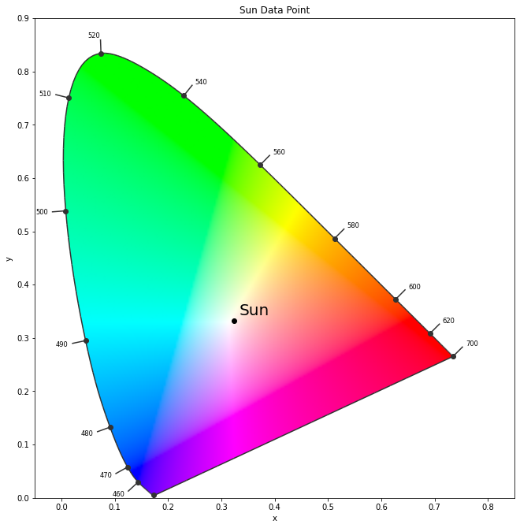
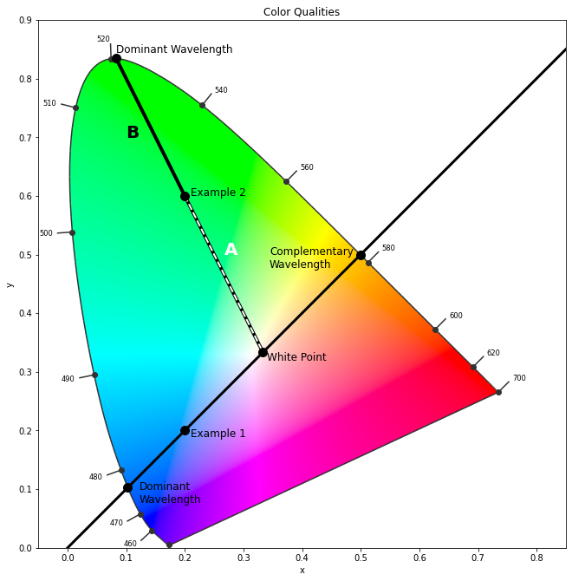
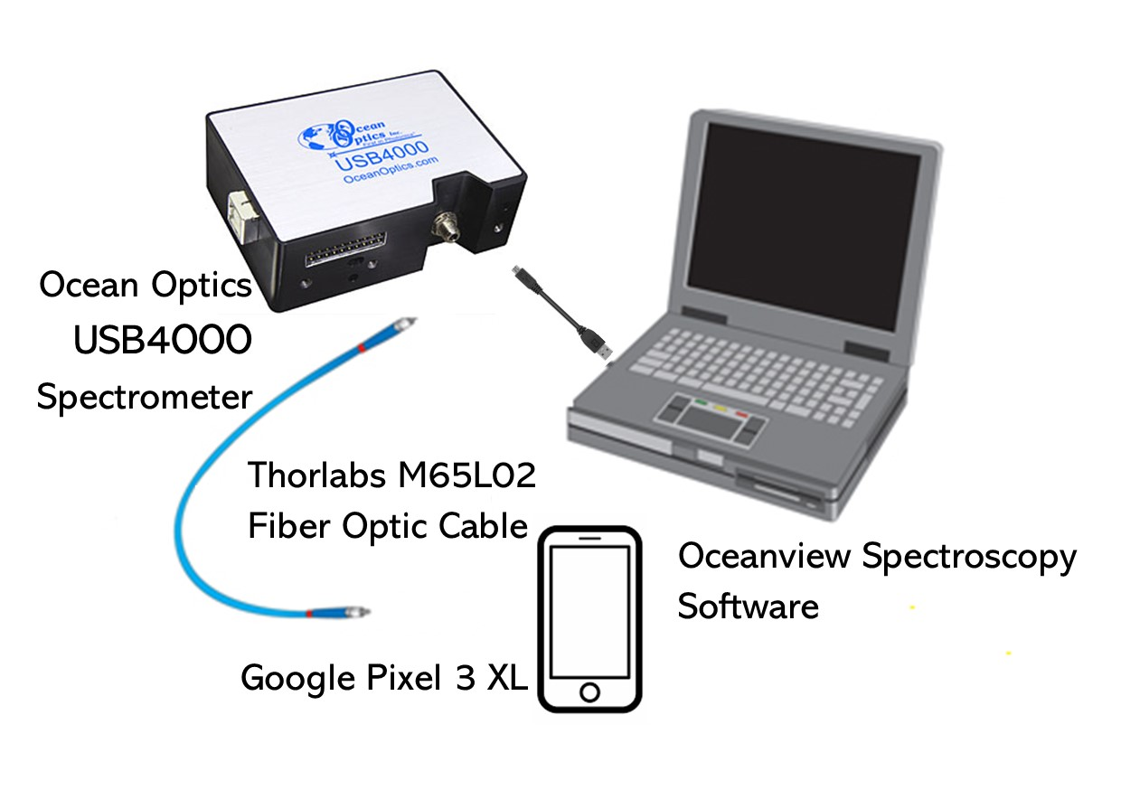
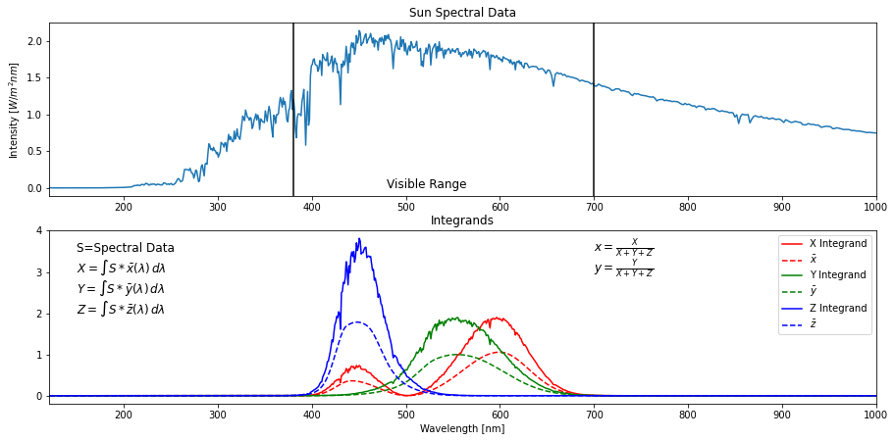


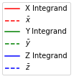
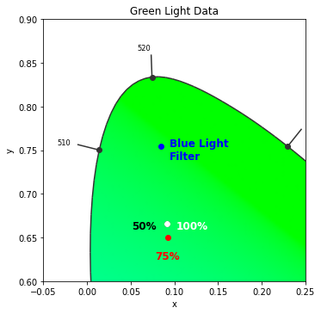
Light Emission from Cell Phones: Spectrum Analysis
PY 452
Ryan Branagan, Jared Kempton, Dali Sun
Objectives
Methods
This project aims to investigate the spectrum of the electroluminescence emission collected from the cell phones using an ocean-optics spectrum analyzer. The purity of the color spectrum would be analyzed, by which the color coordinates will be determined.
0.9
Sun Data Point
Color Qualities
The dominant (1) and complementary (2) wavelength are found by drawing a line between the xy coordinate and the “white point”. The white point is the point chosen to be white light
0.8
The colorful graph on the left shows the xy color space. It is bounded by the spectral locus comprised of points belonging to monochromatic light, light of a single wavelength. Anything inside the boundary is a combination of various wavelengths of light. The bottom line is called the line of purples and does not have a single wavelength but is a mixture of red and blue.
1
A
B
B
2
Ex. 1
A
Ex. 2
0.4
Sun
Sun Spectral Data
y
White
Point
1
0.0
Intensity
[W/(m^2)nm]
CP(3) = A/B
0.0
0.4
0.8
corresponding to equal intensity of all wavelengths. The boundary closest to the data point is the dominant wavelength and the other side is the complementary wavelength. To calculate the color purity (3) we take the ratio of the distance A/B between the dominant wavelength and the white point, and the xy coordinate and the white point.
x
Visible Range
To create our python script we started with simple data from the sun. We plotted this on a color map which showed the color of the sun as white; which is to be expected.
Integrands
Results
200
300
400
500
600
700
800
900
1000
Wavelength [nm]
0.9
Green Light Data
Conclusions
References
Green Light Data | 50% | 75% | 100% | Blue Light Filter
xy | (0.091 , 0.665) | (0.093 , 0.650) | (0.092 , 0.665) | (0.084 , 0.755)
Dominant Wavelength | 511.030 | 510.197 | 511.064 | 516.079
Color Purity | 76.8% | 75.5% | 76.7% | 86.6%
520
We notice that the blue light filter data points are noticeably shifted away from blue. This shows the filter is working as advertised. Brightness data shows that a change in screen brightness does not affect color. All reported color purities are above 75% showing good purity.
Color Matching Function—An overview | ScienceDirect Topics. (2020). Retrieved October 22, 2020, from https://www.sciencedirect.com/topics/engineering/color-matching-function
Measuring radiometric spectra and CIE color space of light sources with the FLAME spectro-radiometer — Spectrecology. (n.d.). Retrieved October 22, 2020, from https://www.spectrecology.com/flame-spectrometer/
Standard Solar Spectra. (n.d.). Retrieved October 23, 2020, from https://www.pveducation.org/pvcdrom/appendices/standard-solar-spectra
Wyman, Chris; Sloan, Peter-Pike; Shirley, Peter (July 12, 2013). "Simple Analytic Approximations to the CIE XYZ Color Matching Functions". Journal of Computer Graphics Techniques. 2 (2): 1-11. ISSN 2331-7418.
Wyszecki, Günter & Stiles, Walter Stanley (2000). Color Science: Concepts and Methods, Quantitative Data and Formulae (2E ed.). Wiley-Interscience. ISBN 0-471-39918-3.
y
0.75
510
0.6
0.0
0.1
0.2
x

Slide 2
Light Emission from Cell Phones: Spectrum Analysis
1
Ryan Branagan and Jared Kempton
Notes:
Ryan
Ryan introduces self -> Jared introduces self -> Jared introduces objective Hi I am…. And we are investigating light emission from cell phones
Next slide: Jared

Slide 3

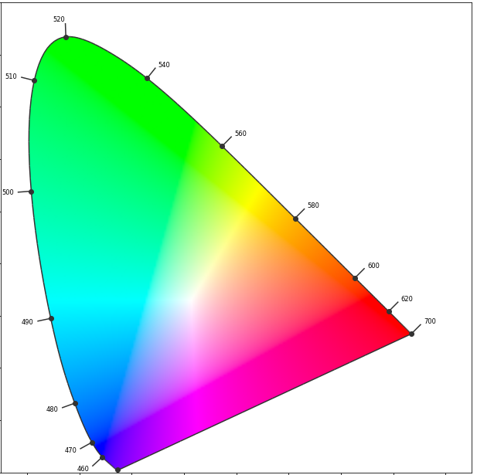
Introduction: Objective
2
Goal: Analyzed light from cell phone LEDs
Our Questions:
Color Purity?
Brightness?
Blue light filter?
Notes:
Jared
In this experiment we specifically investigated
How pure is the color of the phone’s LEDs?
Does the brightness of the phone’s screen affect the color purity?
Does the built in blue light filter on the phone affect the color and work as advertised?
Next Slide: Jared

Slide 4
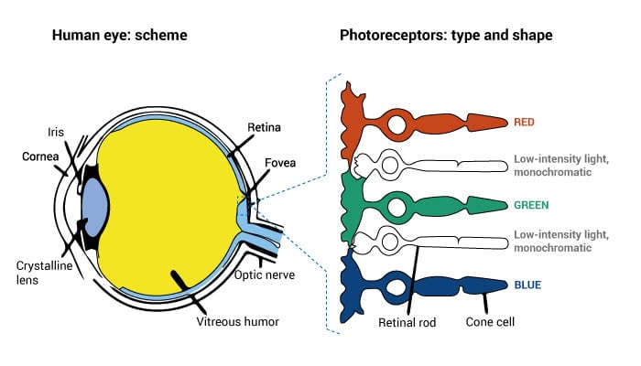
Introduction: Human Vision
3
How humans see:
Cones and rods are sensitive to light
Cones are what let us see color
Notes:
Jared
For a quick reminder on how human eyes see light
Let’s propose a ray of light leaving a cell phone screen, how does it go from a ray of light to color that we see?
The answer -> we have photoreceptors called Cones and Rods in the back of our eyes -> and the Cones are what allow us to see color. We have 3 different cones that allow us to see Red, Green, and Blue light.
Next slide: Ryan

Slide 5
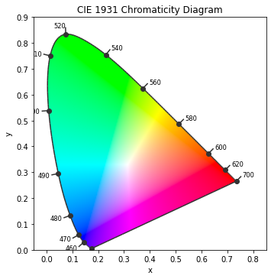
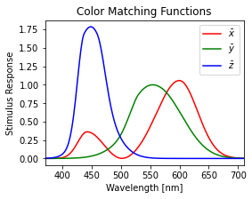
Introduction: The Color Space
4
How do you analyze color?
Key Features of the Color Map:
Boundary
White Point
What are color matching functions?
Mathematical
How human eyes respond to color
Notes:
Ryan
How do we analyze light reliably and scientifically?
Answer: Color spaces -> We use the CIE 1931 color space -> specifically the xy color space and chromaticity diagram which is just one representation
Key features are boundary and white point
The boundary is made up of the spectral locus and line of purples
Spectral locus - Made up of monochromatic light
Line of purples - Not made up of monochromatic light
White point: Another key feature is the white point, it is the center of the diagram but can be chosen to whatever best suits your application, for example white light will be perceived differently outdoors vs indoors, the sun vs a lamp. We used what’s called Illuminant E, the equal energy emitter, which means that all wavelengths have equal intensity and represents pure white light.
Color matching functions
I also want to talk about color matching functions, we’ll talk more about how they’re used later in the presentation. Their meaning can be confusing, if you want you can think about them as mathematical constructs that get you from data to a point in the chromaticity diagram, however it is important to note that they are only colored red, green, and blue by convention and do not directly represent these colors. What they represent is complex and can be thought of as how human eyes respond to color.
Next Slide: Jared

Slide 6
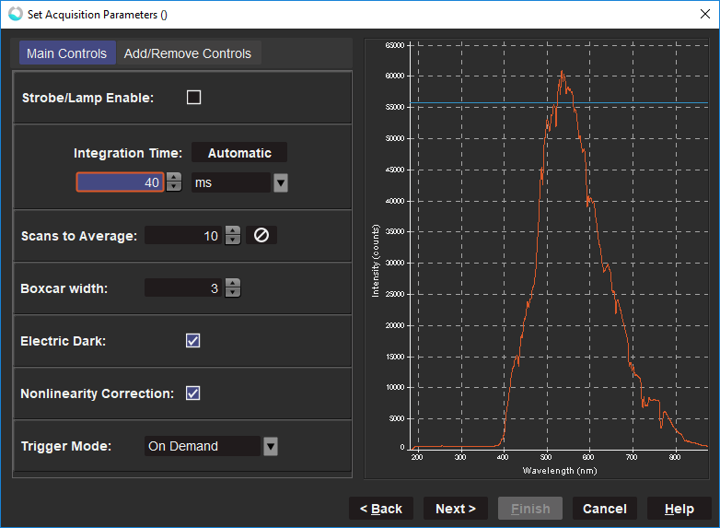
Methods: Data Collection
5
Our Experimental Setup:
Spectroscopy Software:
300
5
3
Notes:
Jared
For the data collection, rather than measuring the light with our eyes we measured it using a spectrometer and recorded as spectrum data.
On the left you can see our experimental setup, which is an Ocean Optics spectrometer that measured light from a Google Pixel 3 XL through a fiber optic cable. This data was collected using a laptop and OceanView Spectroscopy software.
Ideally the data would appear like the image on the right, however,
Due to internal setting issues with our spectrometer we could only measure a limited range of 200-530 nm wavelengths, and because of this we could only measure blue, cyan, and green light.
Next slide: Jared

Slide 7
Methods: Calculating Data Points
6
Obtaining an xy pair in the color space involves applying the color matching functions (CMFs) to data and integrating.
Process Data
Calculate Integrands
Spectral Data * CMFs
Integrate
X = ∫S*xbar(λ)dλ
Y = ∫S*ybar(λ)dλ
Z = ∫S*zbar(λ)dλ
Calculate xy pair
x = X/(X+Y+Z)
y = Y/(X+Y+Z)
Notes:
Jared
To calculate our data, we first needed to calibrate our python code, for this we used data from the sun because not only is it readily available, we also understand what the sun looks like. And it also covers the entire spectrum with some in the visible, UV and infared. If you look at the top right graph you can see the sun data that we used.
Once we have data it has to be processed to be put on the color map. To put this data on the color map we need to calculate the XYZ values or what's called the tristimulus values. To achieve this we integrated our data with color matching functions. Once we have the tristimulus values we can calculate the xy values that will plot our data on the color map.
Since we are using the sun as an example, the corresponding color matching functions are not too interesting. You can see this on the bottom right graph. The dotted lines are the color matching functions. The solid lines are the integrands of our data, which is being multiplied by the color matching functions. Since the sun has all wavelengths of light, the color matching functions are essentially just scaled versions of the integrands. If we had used blue light for our example, we wouldn’t necessarily see peaks on the right side, and would see higher peaks on the left.
Next slide: Ryan

Slide 8

Methods: Calculating Quantities
7
Important Values:
Dominant Wavelength
Complementary Wavelength
Color Purity
A
B
Notes:
Ryan
Okay so now that we know how to plot points on the color map, what can we learn from them? We would like to know color purity but we need a few things to get it.
If we look at example 1, we draw a line between the point and the white point then extend it. Where it intersects the boundary closest to the point is the dominant wavelength. On the opposite side of the white point is the complementary wavelength. If you want to know more about our process, ask us after the presentation.
Now that we have dominant wavelength we can talk about color purity. If we look at example 2, we can define 2 distances A and B. A is between the white point and the data point, point B is between the white point and the dominant wavelength. The ratio of the distances is color purity. To put it simpler, it is how close to the boundary the point is or how far from white it is. 0% -> white, 100 -> monochromatic
Next slide: Ryan

Slide 9
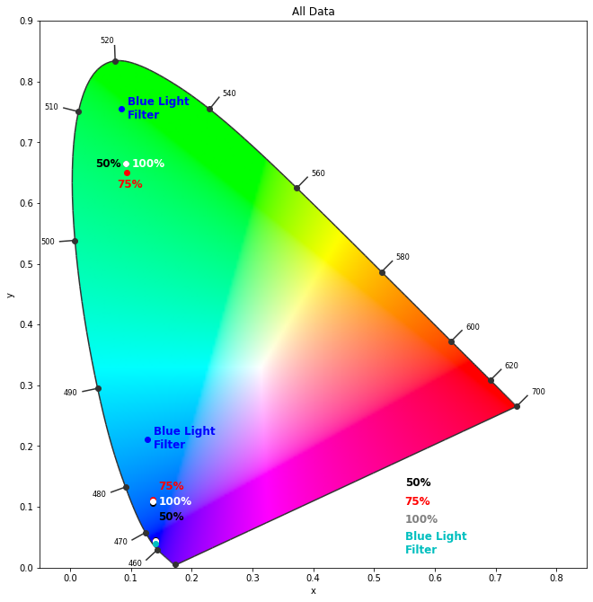
Results
8
Quick Look: All Data Points
Colors Measured - Blue, Cyan, and Green
Screen Settings - 50%, 75%, 100% Brightness, and Blue Light Filter
Notes:
Ryan
Explain what data we collected. Offer to take a quick look at all our data. We will look at the green light data since it is representative of the rest of the data.

Slide 10
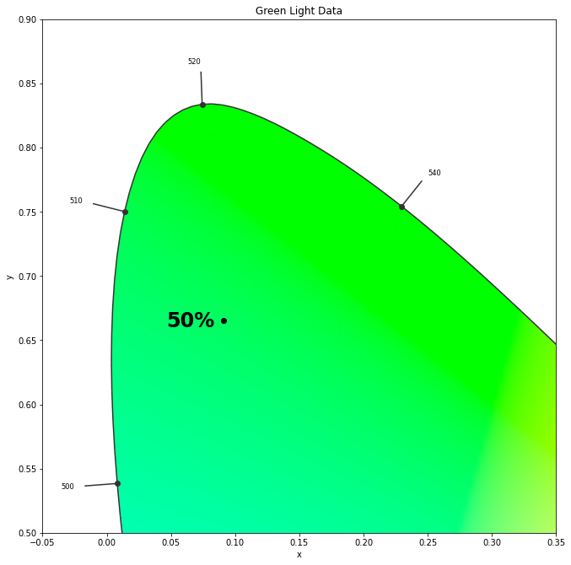
Results
8
Green Light Data:
50% Screen Brightness
Notes:
50% is in black

Slide 11
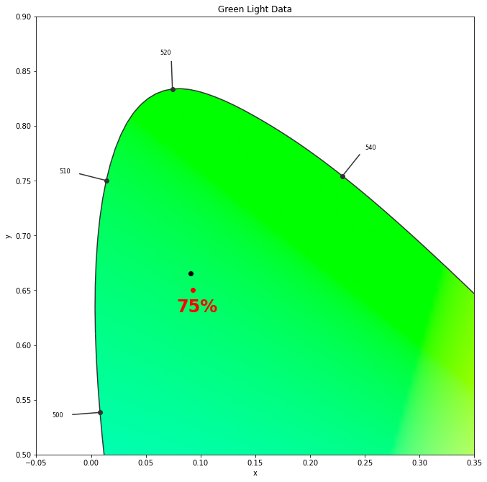
Results
8
Green Light Data:
50% Screen Brightness
75% Screen Brightness
Notes:
75% is in red

Slide 12
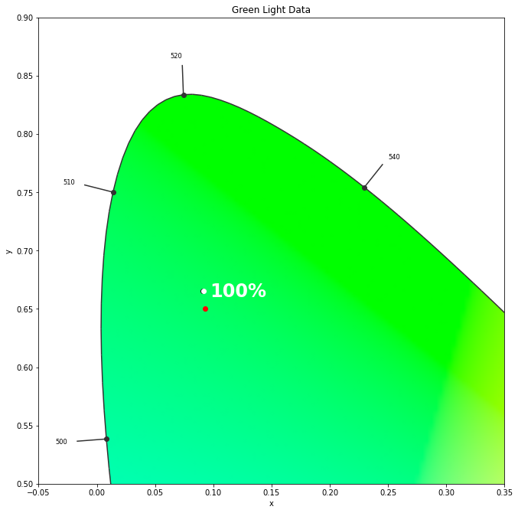
Results
8
Green Light Data:
50% Screen Brightness
75% Screen Brightness
100% Screen Brightness
100%
Notes:
100% is in white and is on top of the 50%. We can notice that all the data points are closely grouped together.

Slide 13
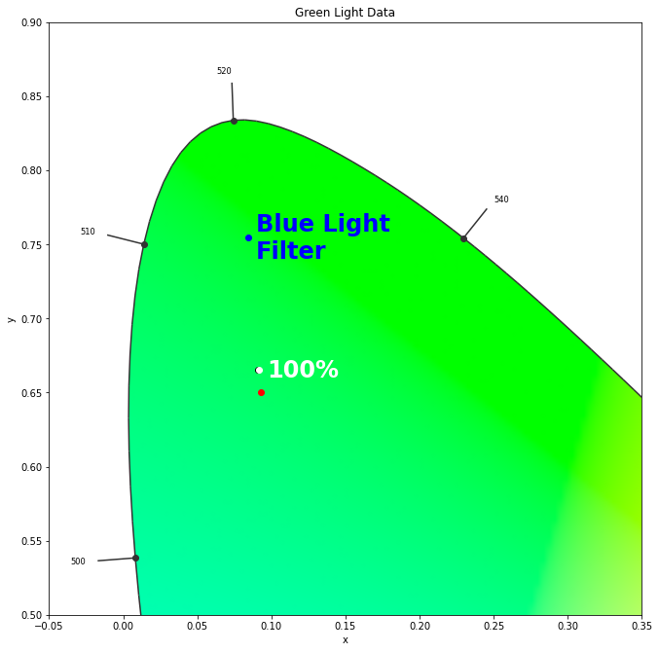
Results
8
Green Light Data:
50% Screen Brightness
75% Screen Brightness
100% Screen Brightness
Blue Light Filter (100%)
100%
Notes:
Blue light filter with 100% brightness is far from the 100% data point without blue filter and is in the opposite direction of the blue.

Slide 14
Results
8
What the data tells us:
Points are close to the boundary
Brightness data is tightly grouped
Blue light filter data is not close to 100% brightness
Notes:
It’s representative of the rest of our data because all the data points are close to the boundary, the brightness data is roughly in the same place, and the blue light filter is away from the blue. This is also shown in cyan. For the blue, you can’t take the blue out of blue so they are all pretty much in the same place.
Next slide: Jared

Slide 15
Conclusion
9
Improper experimental equipment casts greater uncertainty
Color purity for all data is above 75% indicating decent quality
Screen brightness doesn’t affect color
Blue light filter does affect color
Notes:
Jared
Since we have a limited range that doesn’t include red, we aren’t getting the full picture and we don’t know how this affects our results.
All the data points are pretty close to the boundary so we can conclude the LEDs are pretty good at displaying color
Since all the brightness data points are all tightly grouped we can conclude brightness doesn’t affect color purity.
We can see a noticeable difference between the data with the blue light filter on vs off so it does actually work as advertised taking out blue light
Next slide: ???

Slide 16
Acknowledgments
10
Thank you Dr. Sun for being patient with us during these trying times.
And a huge thanks to Colour Science, which allowed us to check our code easily and make better plots.
Succ
Notes:
We’d like to thank Dr. Sun.
Colour Science package made things much smoother.

Slide 17
References
11
Color Matching Function—An overview | ScienceDirect Topics. (2020). Retrieved October 22, 2020, from https://www.sciencedirect.com/topics/engineering/color-matching-function
Measuring radiometric spectra and CIE color space of light sources with the FLAME spectro-radiometer — Spectrecology. (n.d.). Retrieved October 22, 2020, from https://www.spectrecology.com/flame-spectrometer/
Standard Solar Spectra. (n.d.). Retrieved October 23, 2020, from https://www.pveducation.org/pvcdrom/appendices/standard-solar-spectra
OceanInsight. (n.d.). Steps-to-measure-lamp-output-power. Retrieved November 10, 2020, from https://www.oceaninsight.com/globalassets/catalog-blocks-and-images/hints--tips/steps-to-measure-lamp-output-power/step6_oceanview_acquisitionparameters.png
Packly Blog. (2017). Human-eye-scheme-retinal-rod-and-cones. Retrieved November 10, 2020, from https://mk0blogpacklyk444a5k.kinstacdn.com/wp-content/uploads/2017/03/human-eye-scheme-retinal-rod-and-cones.jpg.webp
Sudo Null. (n.d.). Model CIE XYZ. Retrieved November 11, 2020, from https://sudonull.com/post/126584-About-color-spaces
Wyman, Chris; Sloan, Peter-Pike; Shirley, Peter (July 12, 2013). "Simple Analytic Approximations to the CIE XYZ Color Matching Functions". Journal of Computer Graphics Techniques. 2 (2): 1-11. ISSN 2331-7418.
Wyszecki, Günter & Stiles, Walter Stanley (2000). Color Science: Concepts and Methods, Quantitative Data and Formulae (2E ed.). Wiley-Interscience. ISBN 0-471-39918-3.

Slide 18
Any Questions?
12
Improper experimental equipment casts greater uncertainty
Color purity for all data is above 75% indicating decent quality
Screen brightness doesn’t affect color
Blue light filter does affect color
Notes:
Jared
Since we have a limited range that doesn’t include red, we aren’t getting the full picture and we don’t know how this affects our results
All the data points are pretty close to the boundary so we can conclude the LEDs are pretty good at displaying color
Since all the brightness data points are all tightly grouped we can conclude brightness doesn’t affect color purity. It is not unreasonable to think that brightness would affect color purity.
We can see a noticeable difference between the data with the blue light filter on vs off so it does actually work.
Next slide: ???

Slide 19
Supplementary Graphics

Slide 20
